Slide 1

presentation
inventors in the field of programming

Slide 2
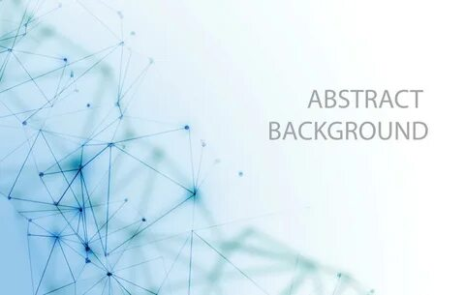
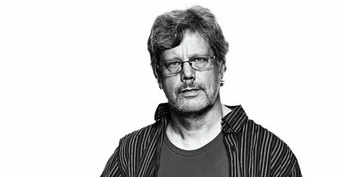
introduction
Guido van Rossum is a renowned Dutch programmer best known as the creator of the Python programming language.

Slide 3

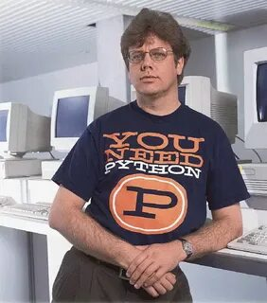
Early Life and Education
Guido was born in the Netherlands in 1956.
He studied computer science at the University of Amsterdam.

Slide 4

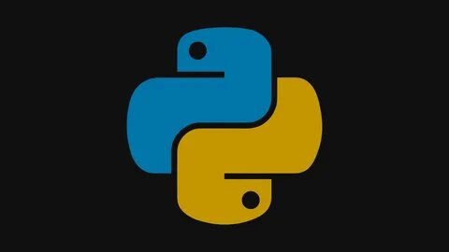
Creation of Python
In 1989, Guido started working on Python as a hobby project to create a language that was easy to read and write. Python was officially released in 1991.

Slide 5

Impact of Python
Python quickly gained popularity due to its simplicity and versatility. Today, it is one of the most widely used programming languages in the world, utilized in web development, data science, artificial intelligence, and more.

Slide 6


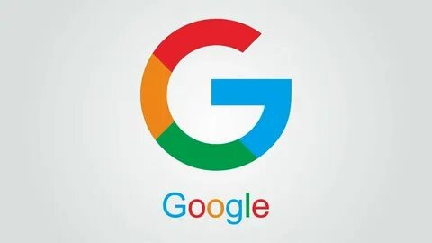
Guido's Contributions and Legacy
Guido has received numerous awards for his contributions to technology. He also worked at Google and later at Dropbox, helping improve Python and its ecosystem. His work has inspired countless programmers worldwide.

Slide 7

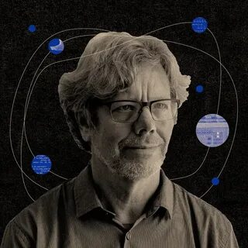
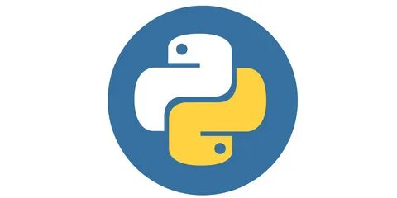
Conclusion
Guido van Rossum is a visionary programmer whose creation of Python has revolutionized the way we write and think about code. His influence continues to shape the future of technology.

